Slide 1
A PAPER PRESENTATION ON “Neural Network with Memory and Cognitive Functions”
Presented By: Suman Sharma
069/MSI/619

Slide 2
Introduction
R-networks are similar to Hebbian networks.
Use simple binary neurons and trained links between excitatory and inhibitory neurons.
Use inhibition to prevent neurons
Ability to store sequential patterns used in networks with higher cognition functions.
Employed learning and recall mechanisms in terms of storage.

Slide 3
Introduction Continue
R-nets stress biological plausibility, large storage capacities with the sparse connectivity of mammalian cortex.
R-net modeled 40% of excitatory neuron pairs linked though at least 1 inhibitory neuron.
Mathematically, R-nets are defined as randomly connected artificial neural networks with primary and secondary neurons.
Implement distributed memories able to recall input patterns.
All links between active primary neurons are trained.

Slide 4
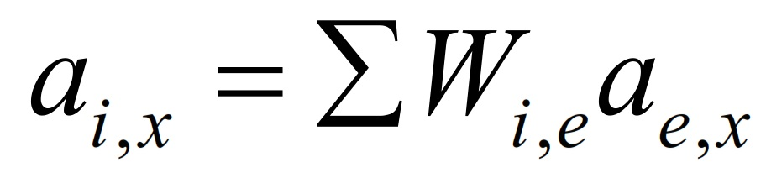
General Description
During recall, inhibitory neurons linearly sum the weighted projections.
Where ai,x represents the activity of the ith inhibitory neuron on the xth cycle.
ae,x is the current activity of the eth excitatory neuron with possible values 0 or 1 and
wi,e is the weight of the projection of the eth excitatory neuron.

Slide 5
Model of R-nets
R-net with 10⁶ excitatory neurons and brain-like connectivity will store at lease 2*10⁸ bits of information.
These numbers are related through
P * kp = S * ks
Where, p = primary neurons, s = set of secondary neurons.
kp = primary neurons outgoing sets
ks = secondary neurons outgoing sets

Slide 6
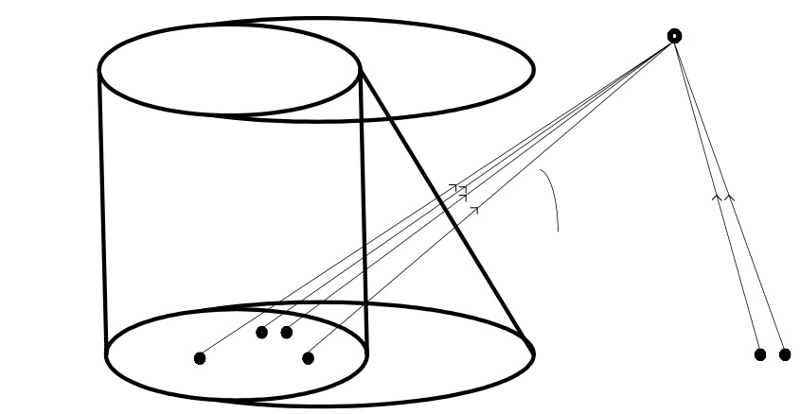
Neurons in R-net
Spurious neurons, are not a part of the original pattern
Activated during recall process
Fig: Spurious neurons and activated secondary

Slide 7
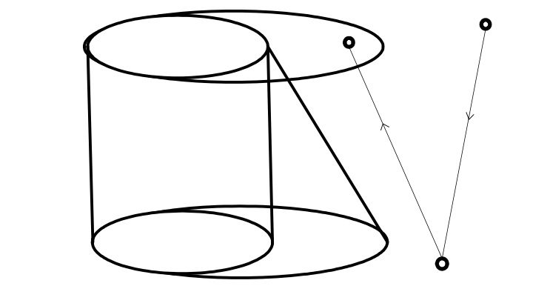

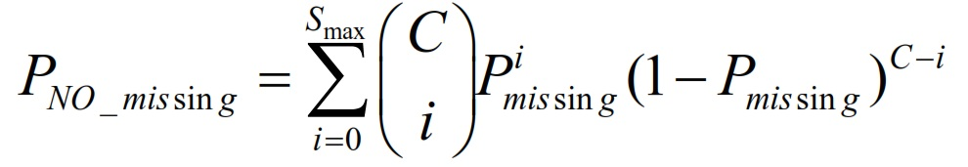
Eliminating Missing Neurons
A missing neurons is a neuron from c-cr.
lemma can be established.
Fig: Creation of mission neurons

Slide 8
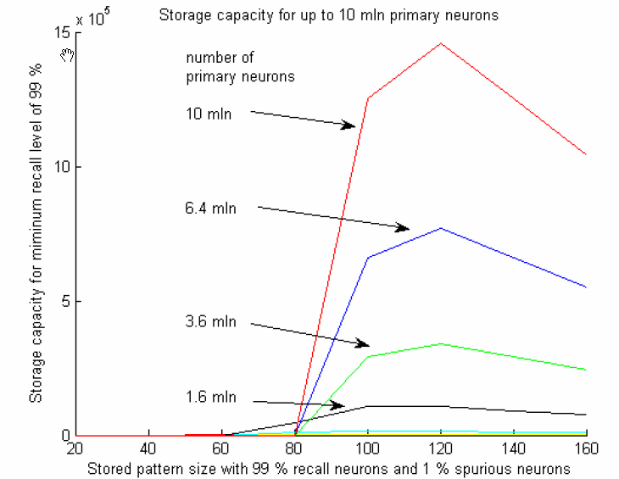
Statistical Model
Fig: Storage Capacity of R-net with up to 10⁷ primary neurons

Slide 9
Conclusion
Demonstrate the role of disinhibiting in paired-pulse
Suggest new understanding of the role of massive projections
Produced computations analogous to serial memory, secondary reinforcement, context dependent classical and operant conditioning
Suggest that the model may be expected to scale up to brain-sized networks efficiently.

Slide 10
References:
Freund, T.F., and Buzsáki, G. (1996). Interneurons of the Hippocampus. Hippocampus. 6, 347-470.
Marr, D. (1971). Simple memory: a theory for archicortex. Philosophical Transaction of the Royal Society of London, B. 262, 23-81.
Vogel, D., and Boos, W. (1997). Sparsely connected, Hebbian networks with strikingly large storage capacities. Neural Networks 10, 671-682.
Vogel, D. (1998) Auto-associative memory produced by disinhibition in a sparsely connected network. Neural Networks. 11: 897-908.

Slide 11
Thank You

